Slide 1
Agile
It is defined as an approach to project management that centres around incremental steps to complete projects.
The incremental parts of a project are carried out in short term development.
For example: Scrum, extreme Programming, Feature drive Development

Slide 2
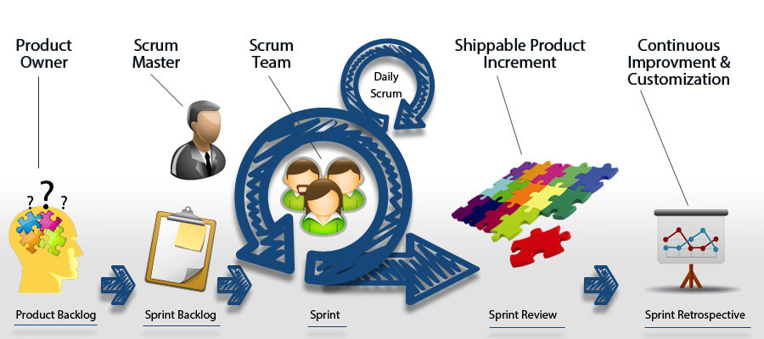
Real Example of Agile

Slide 3
Need of Agile Model
Feature Drive Development
Dynamic System Development method
Teams handling fast changing Deliverables.
Technology products
To improve the quality of their software.

Slide 4
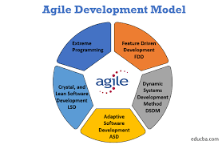
Real Example of Agile Model

Slide 5
Drawbacks of previous models
Less predictable
More time and Commitment
Greater Demands on developers and Clients.
Lack of necessary Documentation.
Projects Easily fall off track.

Slide 6
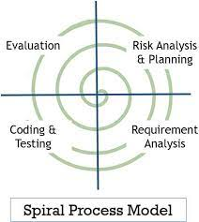
Spiral Model

Slide 7
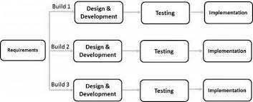
Iterative Model

Slide 8
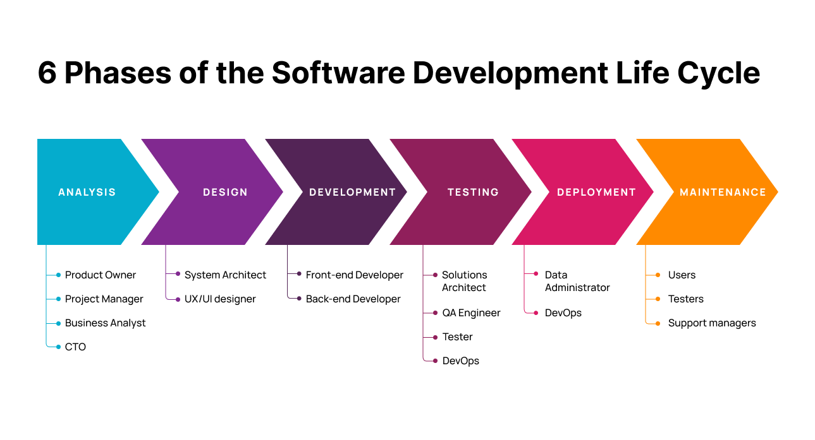
Six phases of the Agile life cycle

Slide 9
